Slide 1
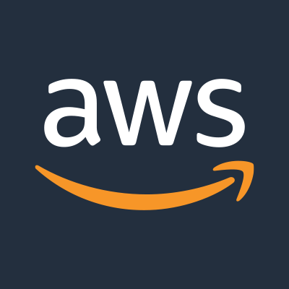
Welcome to Aws Solution Architect TRAINING

Slide 2
What is a Data Centre?
A data Centre is a physical location where companies keep:
• Servers
• Storage devices
• Networking equipment
• Power backup
• Cooling systems
• Security systems
Earlier companies had to buy servers, maintain cooling, electricity, staff, and disaster recovery. Scaling was slow and failures caused downtime. This led to Cloud Computing.

Slide 3
What is Cloud Computing?
Cloud computing means using IT resources over the internet.
• Rent servers instead of buying
• Use provider data centers
• No hardware maintenance
AWS, Azure, and GCP are providers. AWS is the market leader.
Cloud is On-demand, Pay-as-you-go, Scalable, Highly available, and Secure.

Slide 4
Advantages of Cloud Computing
• Cost Saving
• Scalability
• High Availability
• Speed
• Security
• Global Reach
Because of these benefits, companies are rapidly moving to cloud.

Slide 5
Cloud Service Models
IaaS – EC2, EBS, VPC
You manage OS and apps.
PaaS – Elastic Beanstalk, RDS
You manage app and data.
SaaS – Gmail, Office 365
You only use the software.
IaaS = Cook at home
PaaS = Half-prepared food
SaaS = Ready food

Slide 6
Cloud Deployment Models
• Public Cloud
• Private Cloud
• Hybrid Cloud
• Multi-Cloud
Most companies use Hybrid or Multi-cloud strategy.
AWS Architects design solutions using these models.

Slide 7

Cloud Computing
Cloud computing is the on-demand delivery of compute power, database, storage, applications and other IT resources through a cloud services platform via the internet with pay-as-you-go pricing.

Slide 8
Cloud Computing
Whether you are running applications that share photos to millions of mobile users or running any critical workload, a cloud services platform provides rapid access to flexible and low cost IT resources. With cloud computing, you don't need to make large upfront investments in hardware and spend a lot of time on the heavy lifting of managing that hardware. Instead, you can provision exactly the right type and size of computing resources you need to power your newest bright idea or operate your IT department. You can access as many resources as you need, almost instantly, and only pay for what you use.

Slide 9
Advantages of Cloud Computing
Cost Efficient Model:
Instead of having to invest heavily in data centers and servers before you know how you're going to use them, you can only pay when you consume computing resources, and only pay for how much you consume.
Stop spending money on running and maintaining data centers:
Focus on projects that differentiate your business, not the infrastructure. Cloud computing lets you focus on your own customers, rather than on the heavy lifting o[ racking, stacking and powering servers.

Slide 10
Advantages of Cloud Computing
Stop guessing capacity (Elasticity or Scalable):
Eliminate guessing on your infrastructure capacity needs. When you make a capacity decision prior to deploying an application, you often either end up sitting on expensive idle resources or dealing with limited capacity. With cloud computing, these problems go away. You can access as much or as little as you need and scale up and down as required with only a few minutes notice.
Increase speed and agility: In a cloud computing environment, new IT resources are only ever a click away, which means you reduce the time it takes to make those resources available to your developers from weeks to just minutes. This results in a dramatic increase in agility for the organization, since the cost and time it takes to experiment and develop is significantly lower.

Slide 11
Advantages of Cloud Computing
Go global in minutes:
Easily deploy your application in multiple regions around the world with just a few clicks. This means you can provide a lower latency and better experience for your customers simply and at minimal cost.

Slide 12
Service Models
SaaS Software as a Service
PaaS Platform as a Service
IaaS Infrastructure as a Service

Slide 13
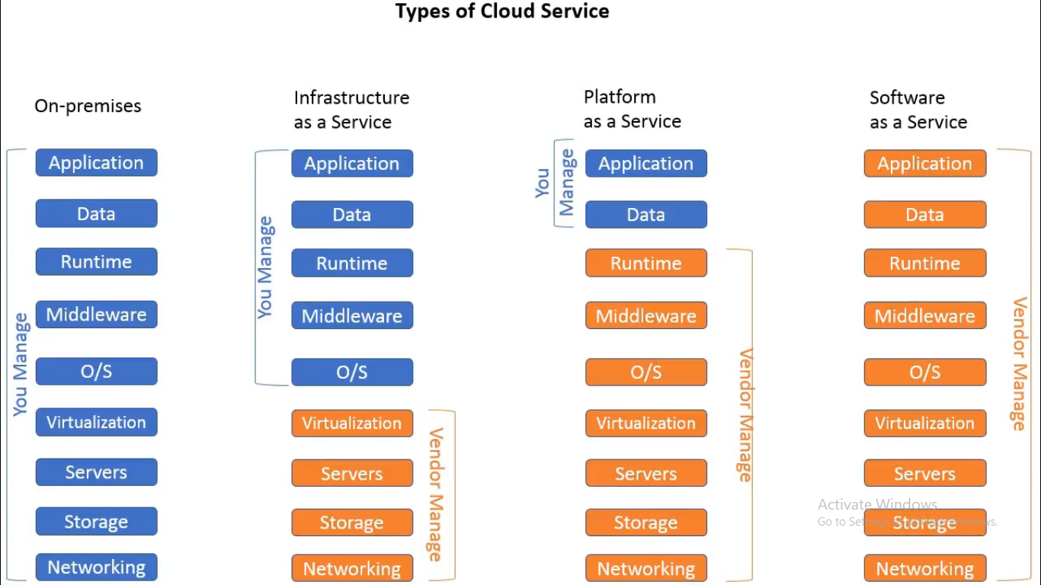

Slide 14
Public Cloud
The cloud infrastructure is provisioned for open use by the general public. It may be owned, managed, and operated by a business, academic, or government organization, or some combination of them. It exists on the premises of the cloud provider.
• Computing resources, such as virtual machines (VMs), applications or storage, available to the general public over the internet.
• It reduces the need for organizations to invest in and maintain their own on-premises IT resources.
• It enables scalability to meet workload and user demands.

Slide 15
Private Cloud
The cloud infrastructure is provisioned for exclusive use by a single organization comprising multiple consumers. It may be owned, managed, and operated by the organization, a third party, or some combination of them, and it may exist on or off premises.
• A private cloud is dedicated to a single organization.
• Private cloud offers hosted services to a limited number of people behind a firewall, so it minimizes the security concerns some organizations have around cloud. Private cloud also gives companies direct control over their data.

Slide 16
Hybrid Cloud
The cloud infrastructure is provisioned for open use by the general public. It may be owned, managed, and operated by a business, academic, or government organization, or some combination of them. It exists on the premises of the cloud provider.
• Computing resources, such as virtual machines (VMs), applications or storage, available to the general public over the internet.
• It reduces the need for organizations to invest in and maintain their own on-premises IT resources.
• It enables scalability to meet workload and user demands.

